Slide 1
Open Strategy
Notes:
Chapter 1: p. 21-40

Slide 2
Why the traditional way of developing strategy
does not work

Slide 3
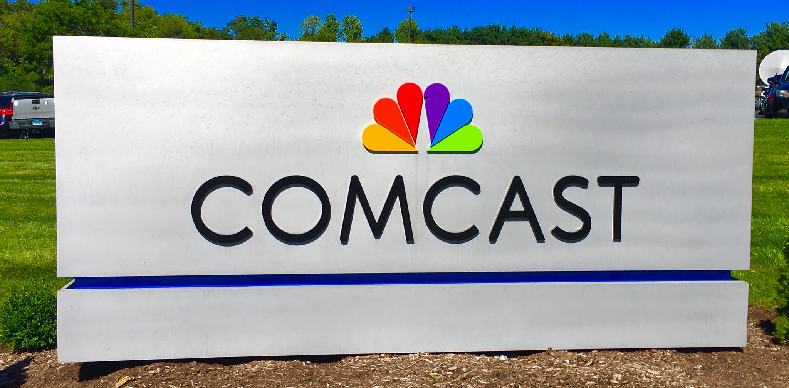
Isomorphism
Notes:
Read about Isomorphism – see p. 5-7

Slide 4


Silo Thinking
Notes:
Unimagined Strategies p. 7-10
p. 9: Story about Sony and how departments and individuals compete with one another for resources or prestige. They don’t trust one another, and they clam up. Even when the powers that be mandate cooperation and silo-busting, the ideas still don’t flow freely. At Sony during the 1990s, leaders unveiled their “Sony United” silo-busting initiative in hopes of boosting innovation and tapping into the freewheeling spirit of the company’s founders. Yet they couldn’t overcome the competitiveness of individual departments within the company.

Slide 5

Unpopular strategies
Notes:
Unpopular Strategies: p. 15-17
Example of Daimler p. 15- 16 to explore employee motivation: When a small coterie of executives undertake to chart a company’s strategy, they so often fail to consider whether they can mobilize employees to execute. Will employees get behind their thinking? Will they push as hard as they can? Will they feel a strong sense of ownership? Quite often, the answer is no, because employees haven’t had a hand in creating or debating the strategy.

Slide 6
The alternative:
Open
Strategy

Slide 7


Slide 9
Nightmare Competitor Exercise – a powerful tool
Notes:
p.130

Slide 10

CO2 free
steel at
VoestAlpine
Notes:
Story of VoestAlpine
p.136 –p.138

Slide 11

Steps to develop a NMC
Notes:
p.130

Slide 12

Exercise:
Develop a nightmare competitor for your university

Slide 13
Selection of participants
Equal number of internal and external participants
Step 1
Notes:
p.132

Slide 14
Starting to think about disruption
Write down newspaper headlines, capturing disruption in higher education over the next 15 years
Step 2

Slide 15
Write down as many disruptive ideas as you can think of on a post-it note
Step 3

Slide 16
1) Everyone picks an idea individually, and explains to her group why this will be a nightmare for your university
2) Group selects one idea, then develops the idea further, names it, and start to think of a pitch
Step 4

Slide 17
Each group pitch their idea to the class
Step 5

Slide 18
The big vote! (which nightmare competitor is most promising)
Step 6

Slide 19
Business model logic of NM
Step 7
POSITIONING LOGIC
What’s your vision?
What are the characteristics of your main (potential) competitors?
What is your Unique Selling Proposition?
PRODUCT & SERVICE LOGIC
Which problem do you solve for your customer(s)?
Describe your offering (products & services)
REVENUE LOGIC
What are potential revenue models for your offering?
VALUE CHAIN LOGIC
Which resources are required for providing your offering?
Which key activities are undertaken by you, which by partners?
Who are required partners?
MARKETING & SALES LOGIC
Which distribution & marketing channels does your company use to target new markets?
How do you maintain the relationship with your customer(s)?

Slide 20
Use your Nightmare Competitor

Slide 21
Fight the disruptor
Become the disruptor
Notes:
p.130

Slide 22
Discuss nightmare competitor implications for your university

Slide 23
Takeaways

Slide 24
Open Strategy is a viable alternative to traditional strategy making – avoiding some of the persistent biases
Nightmare Competitor Contest is a straightforward workshop based open strategy process in 7 steps
Key is the involvement of externals!

